Slide 1

Programming Fundemetals Project
Fall 2021

Slide 2
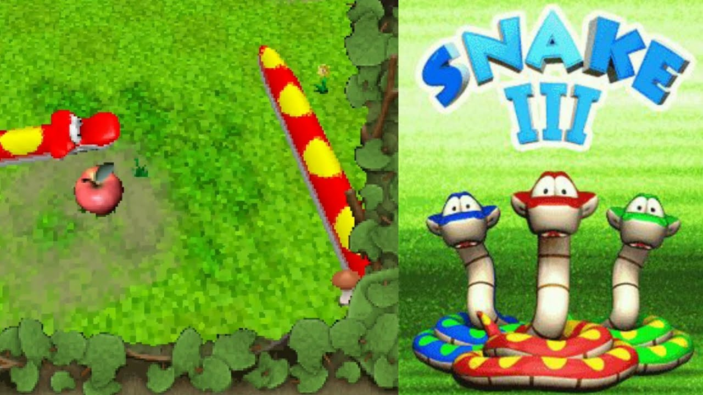
Snake Game

Slide 3
Data Types Used:
1. Variables
2. Functions
3. Conditions
4. Loops

Slide 4
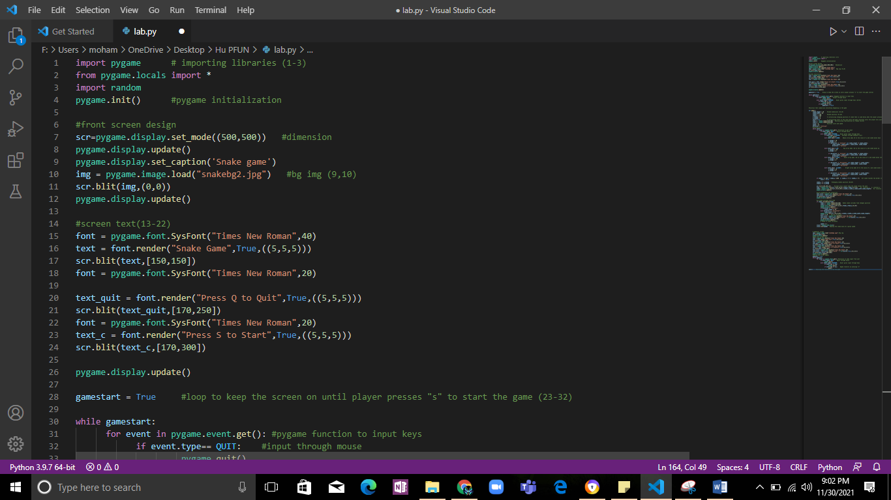
To make this game we imported two libraries:
1. Pygame
2. Random

Slide 5
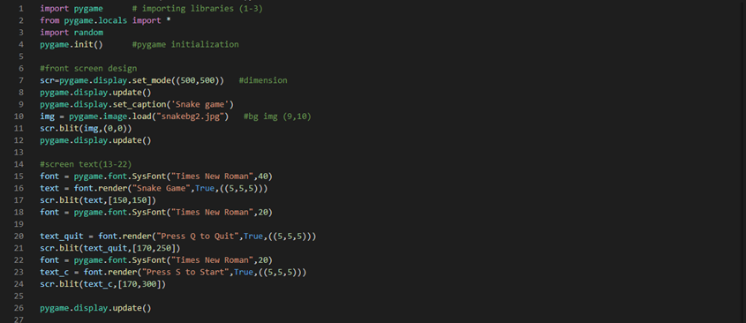

Slide 6
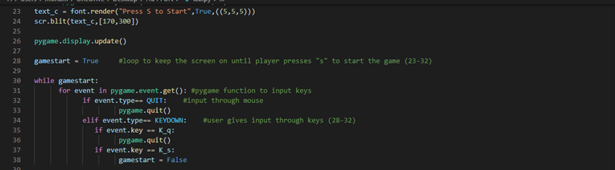

Slide 7
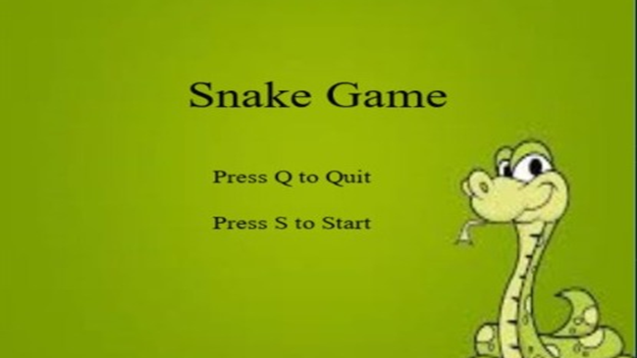

Slide 8
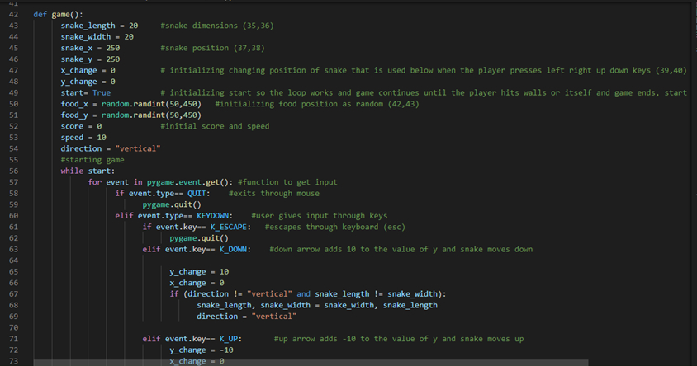

Slide 9
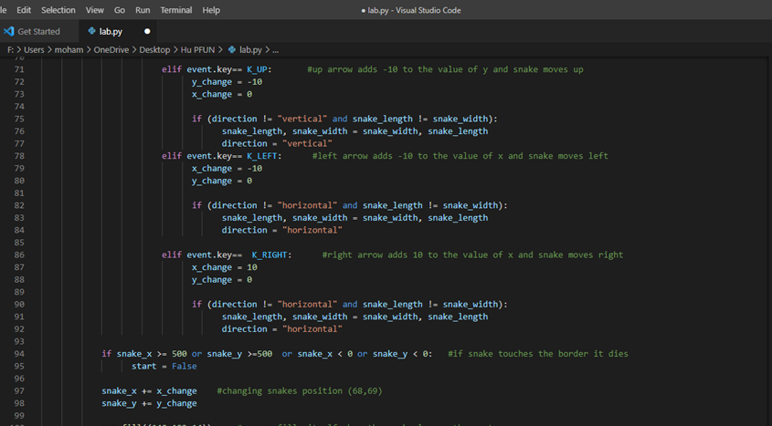

Slide 10
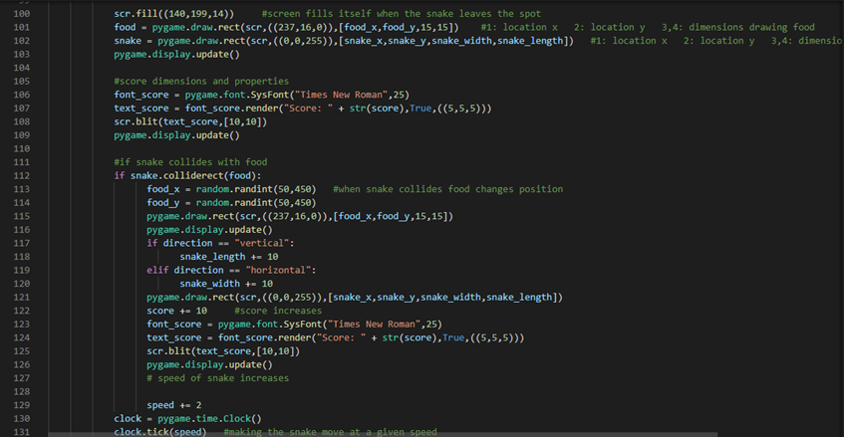

Slide 11
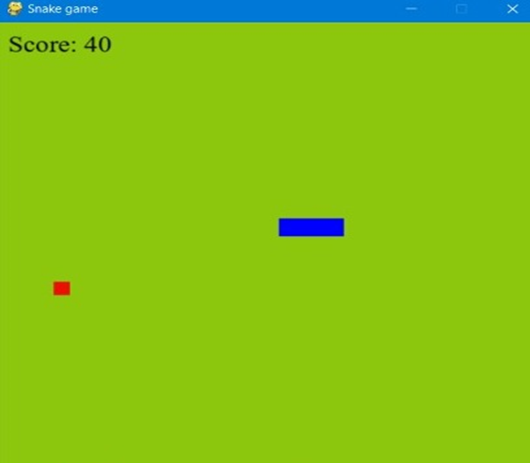

Slide 12
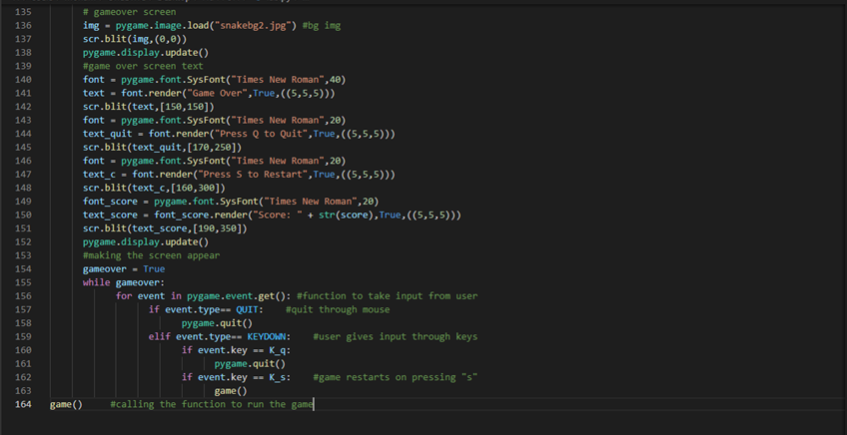

Slide 13
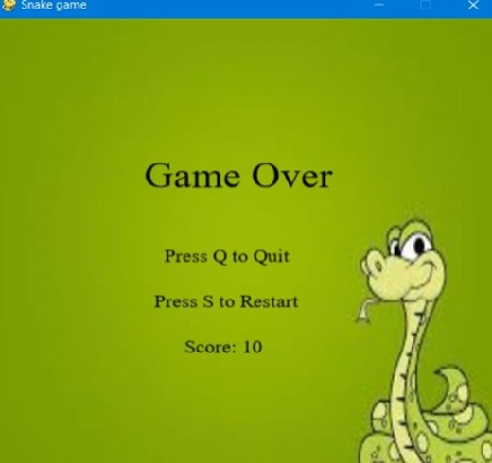

Slide 14
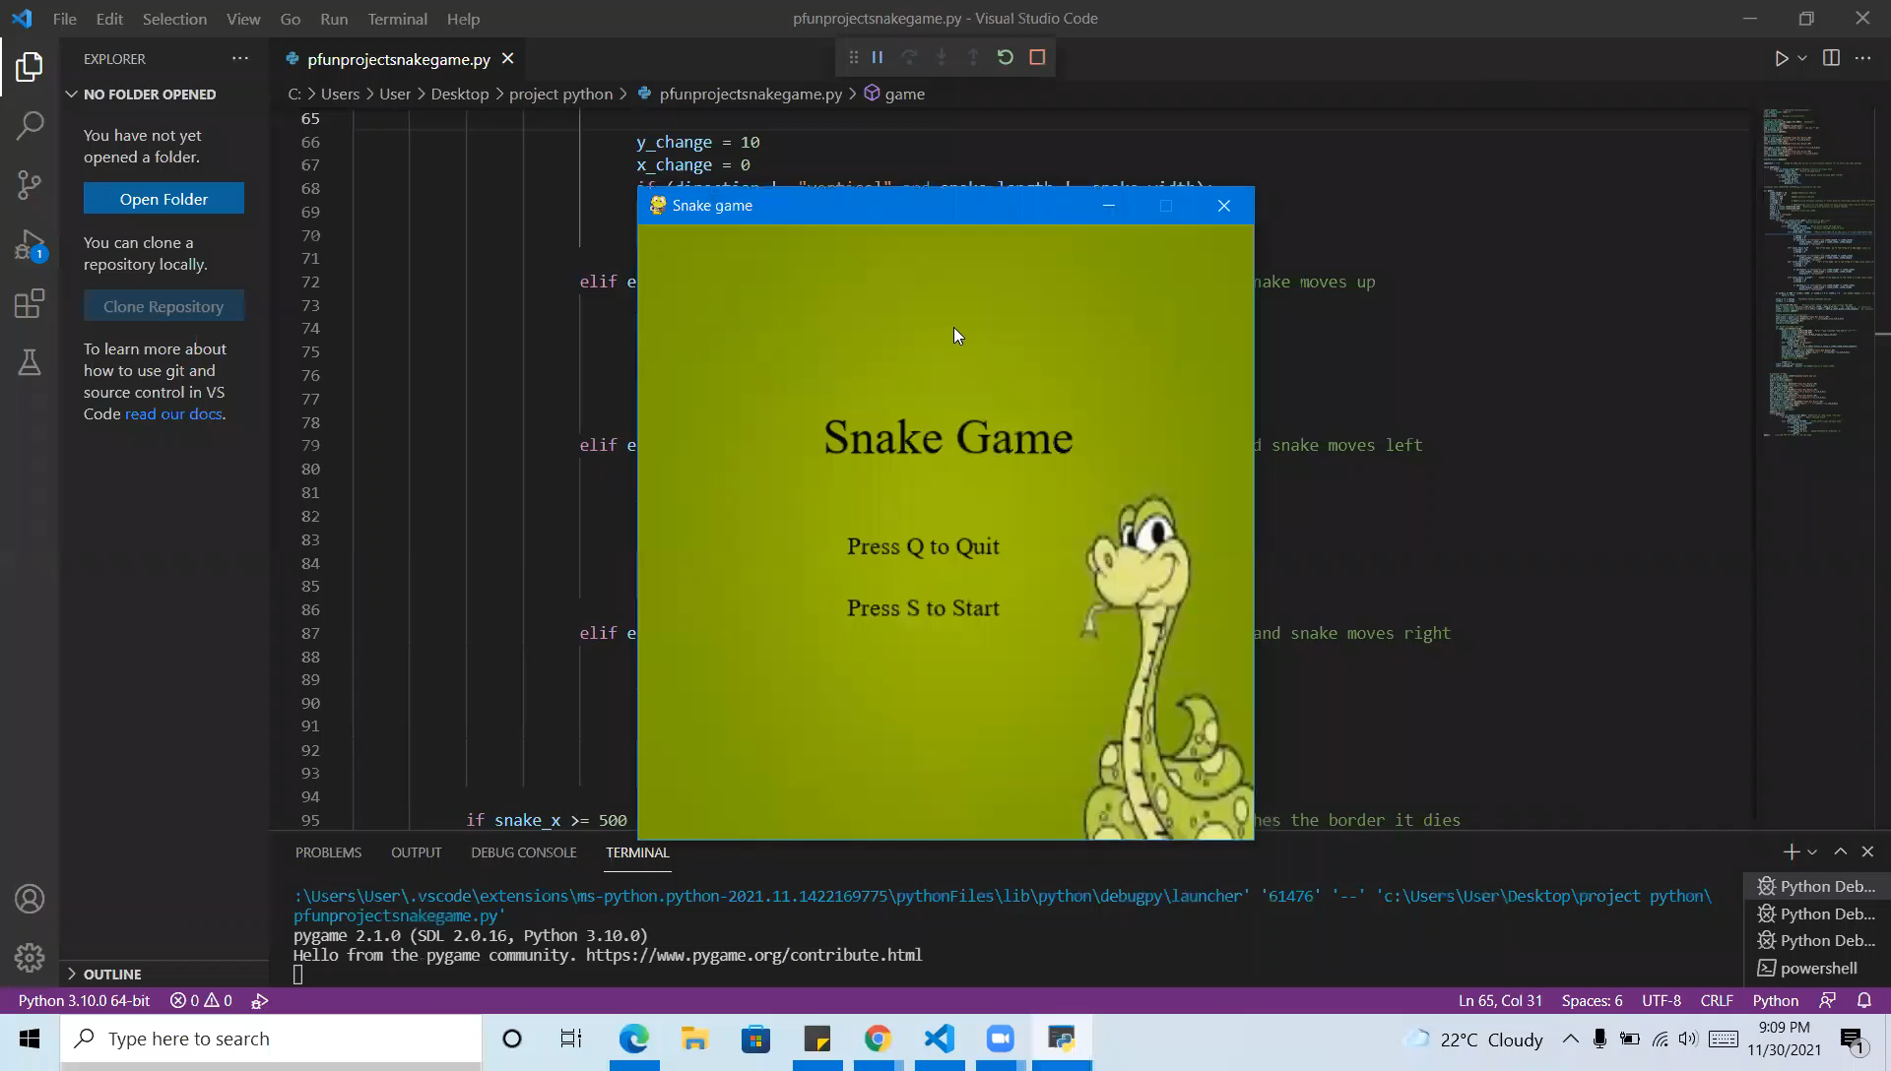

Slide 15

Thank You
This Photo by Unknown author is licensed under CC BY-ND.

